Slide 1
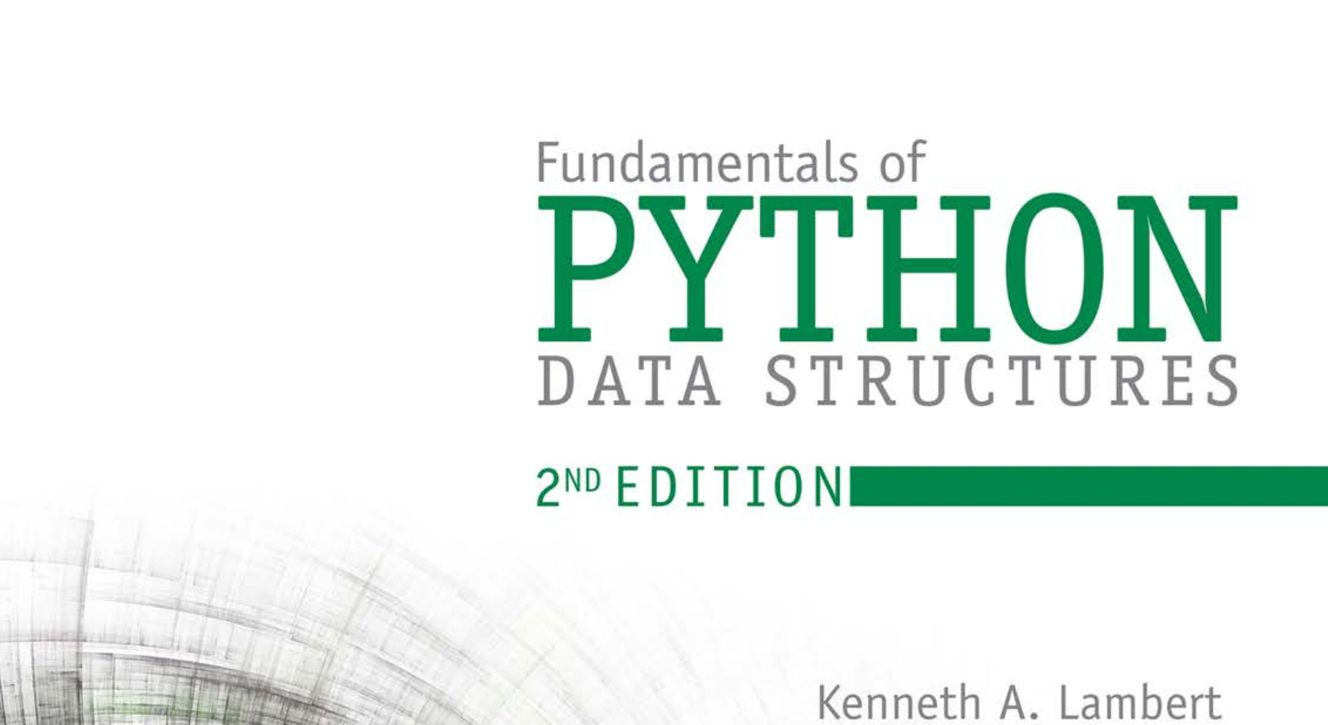
Database Systems: Design, Implementation, and Management 14th Edition
Chapter 1
Database Systems

Slide 2


National Economics University Faculty of Data Science & Artificial Intelligence
Fundamentals of Python: Data Structures – Recursion
Instructor: Duc Minh Vu (FDA – SLSCM Lab)
Email: minhvd [at] neu.edu.vn
12/19/2024
Database System Design, Implementation And Management
2

Slide 3
Learning Objectives
Measure the performance of an algorithm by obtaining running times and instruction counts with different data sets
Analyze an algorithm’s performance by determining its order of complexity, using big-O notation
Distinguish the common orders of complexity and the algorithmic patterns that exhibit them

Slide 4
Learning Objectives
After completing this chapter, you will be able to:
Distinguish between the improvements obtained by tweaking an algorithm and reducing its order of complexity
Write a simple linear search algorithm and a simple sort algorithm

Slide 5
2.2 What is Recursion?
Any function which calls itself is called recursive.
A recursive method solves a problem by calling a copy of itself to work on a smaller problem.
Recursion step.
Recursion step can result in many more such recursive calls

Slide 6
2.3 Why Recursion?
A useful problem solving technique borrowed from mathematics.
Shorter and easier to write than iterative code.
Useful for tasks that can be defined in terms of similar subtasks.
Sort, search, and traversal problems often have simple recursive solutions.

Slide 7
2.4 Format of a Recursive Function
1. Base cases: These tell the recursion when to terminate, meaning the recursion will be stopped once the base condition is met
2. Recursive cases: The function calls itself recursively, and we progress toward achieving the base criteria

Slide 8
Factorial
n! is the product of all integers between n and 1. The definition of recursive factorial looks like:
n! = 1 if n = 0
n! = n * (n-1)! if n > 0

Slide 9
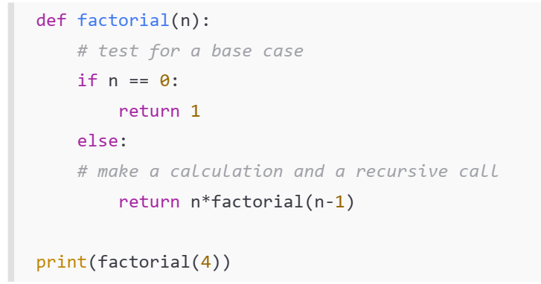
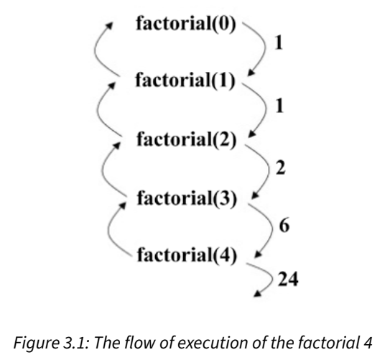

Slide 10
2.6 Recursion versus Iteration
Recursion
Terminates when a base case is reached.
Each recursive call requires extra space on the stack frame (memory).
If we get infinite recursion, the program may run out of memory and result in stack overflow.
Solutions to some problems are easier to formulate recursively.
Iteration
Terminates when a condition is proven to be false.
Each iteration does not require extra space.
An infinite loop could loop forever since there is no extra memory being created.
Iterative solutions to a problem may not always be as obvious as a recursive solution.

Slide 11
2.8 Example Algorithms of Recursion
Fibonacci series, factorial finding
Merge sort, quick sort
Binary search
Tree traversals and many tree problems: InOrder, PreOrder PostOrder
Graph traversals: DFS [Depth First Search]
Dynamic programming examples
Divide and conquer algorithms
Towers of Hanoi
Backtracking algorithms [we will discuss in next section]

Slide 12
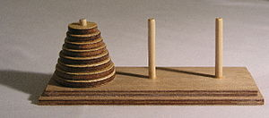
2.9 Recursion: Problems & Solutions
Tower of Hanoi - Wikipedia
It consists of three rods (or pegs or towers) and a number of disks of different sizes which can slide onto any rod.
The puzzle starts with the disks on one rod in ascending order of size, the smallest at the top.
The objective of the puzzle is to move the entire stack to another rod, satisfying the following rules:
Only one disk may be moved at a time.
Each move consists of taking the upper disk from one of the rods and sliding it onto another rod, on top of the other disks that may already be present on that rod.
No disk may be placed on top of a smaller disk.

Slide 13
Tower of Hanoi
Algorithm:
Move m − 1 disks from the source to the spare peg, by the same general solving procedure.
Move the disk m from the source to the target peg.
Move the m − 1 disks from the spare to the target peg by the same general solving procedure
The base case is to move 0 disks (in steps 1 and 3), that is, do nothing—which obviously does not violate the rules

Slide 14
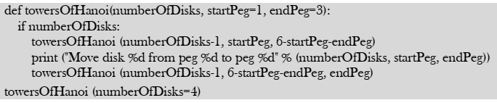

Slide 15
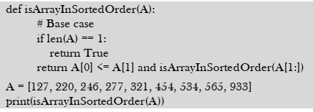
Check whether the array is in sorted order with recursion.

Slide 16
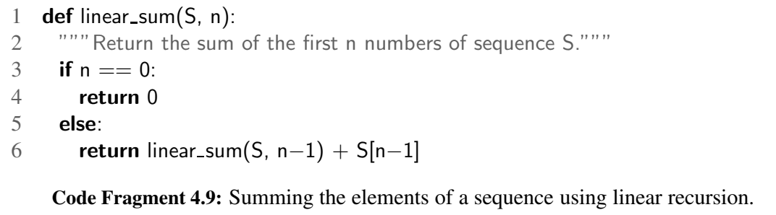
Summing the Elements of a Sequence Recursively

Slide 17
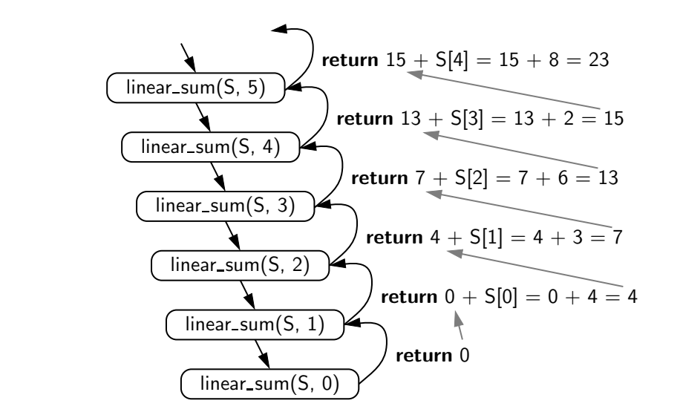
O(n) time
O(n) memory

Slide 18
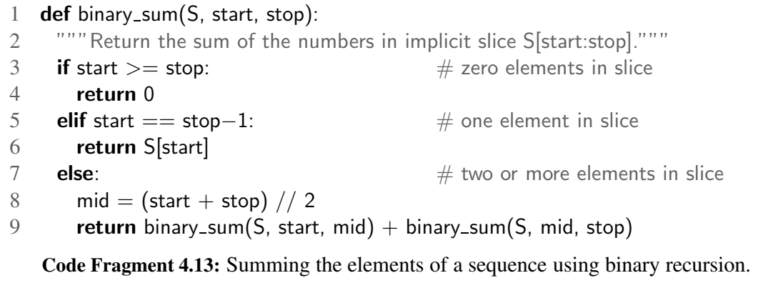
Summing the Elements of a Sequence Recursively

Slide 19
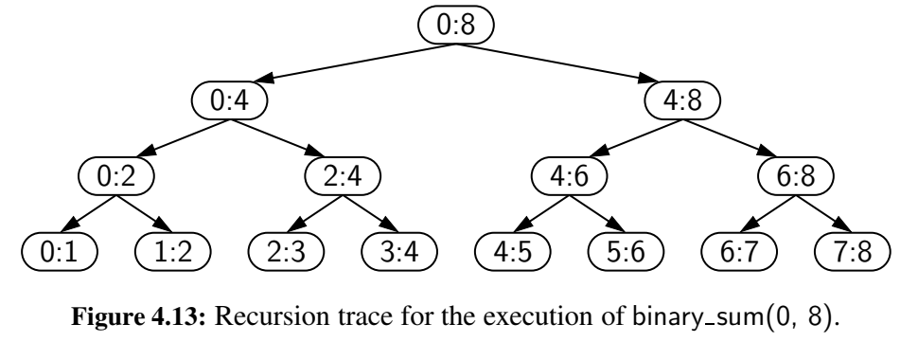
O(n) time
O(logn) memory

Slide 20
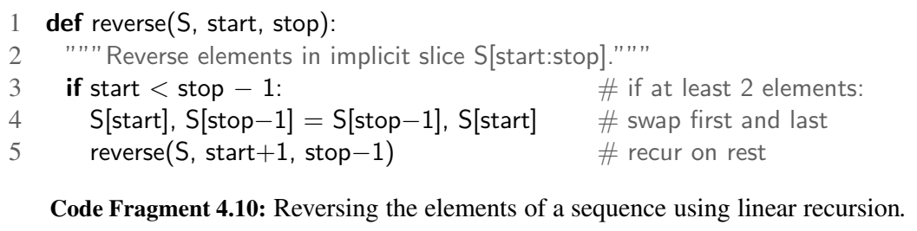
Reversing a Sequence with Recursion

Slide 21
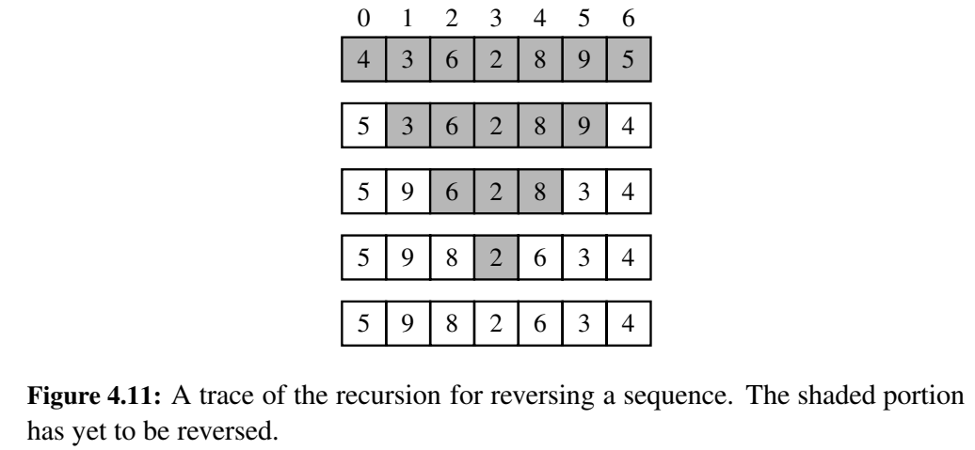
O(n) time
O(n) memory

Slide 22
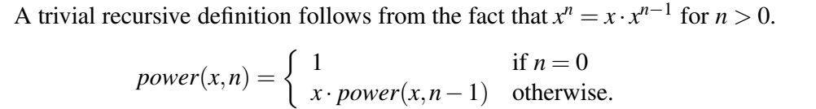
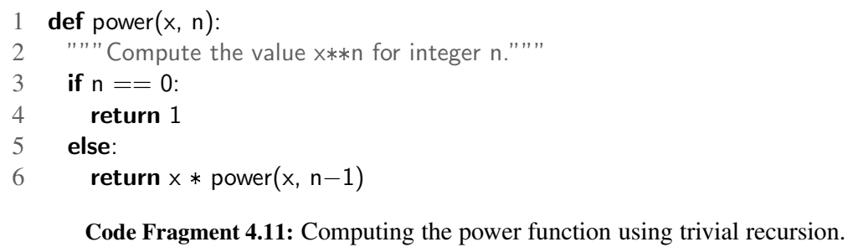
Recursive Algorithms for Computing Powers
O(n) time
O(n) memory

Slide 23
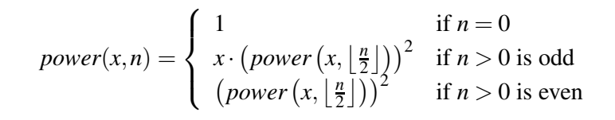
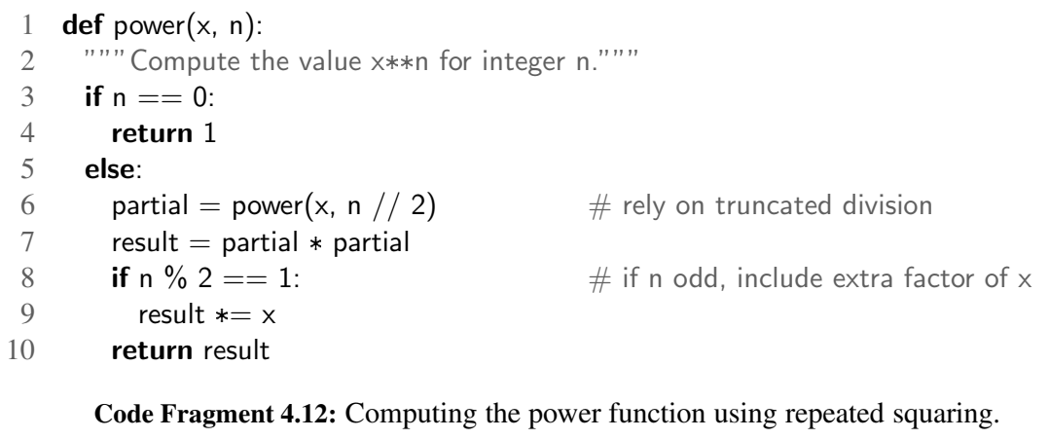
O(logn) time
O(logn) memory

Slide 24
Divide and Conquer Algorithms

Slide 25
Divide and conquer algorithm
An important algorithm design technique based on recursion.
Works by recursively breaking down a problem into two or more sub problems of the same type, until they become simple enough to be solved directly.
The solutions to the sub problems are then combined to give a solution to the original problem

Slide 26
18.2 What is Divide and Conquer Strategy?
The D & C strategy solves a problem by:
1. Divide: Breaking the problem into subproblems that are themselves smaller instances of the same type of problem.
2. Conquer: Conquer the subproblems by solving them recursively.
3. Combine: Combine the solutions to the subproblems into the solution for the original given problem.

Slide 27
